Slide 1
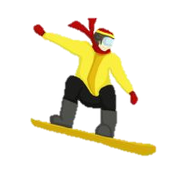
CALCULUS continued
Differentiation and Integration

Slide 2
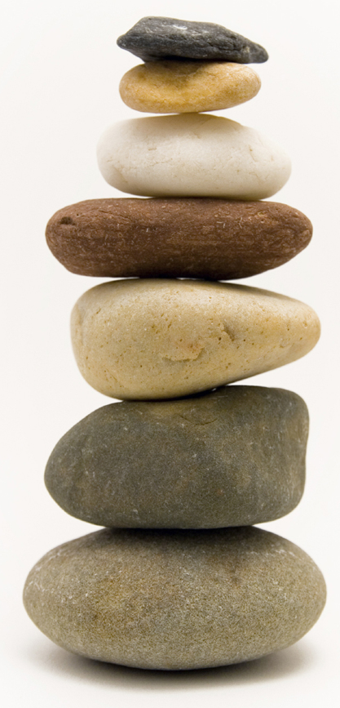
CALCULUS
This is a general word used for a method of reasoning or calculation
We have already used it in Propositional Calculus and Predicate Calculus as we have reasoned about situations using logic with laws, truth tables, trees, Boolean algebra and circuit diagrams
Now we look at two different practical situations which give rise to differential and integral calculus
Calculus, (Latin) a small stone used for counting

Slide 3
Differentiation
We can find the gradient if we have an expression for the line in the form of y = f(x)
Here the two lines might be
y = 2x -3 gradient, m, = 2
x+2y = 5 2y = -x+5
Y = (-x+5)/2 gradient, m, = -0.5
Gradient = 6/3 =2
8
6
-4
3
Gradient = -4/8 =-0.5
3

Slide 4
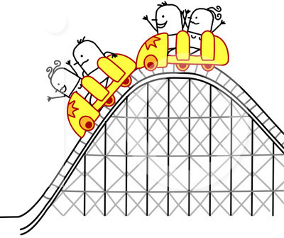
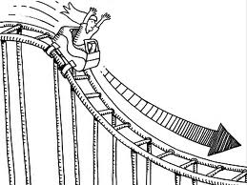
Curves - Changing gradient

Slide 5
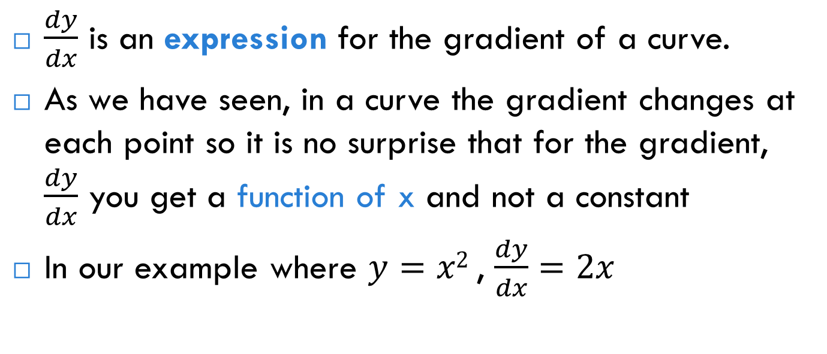
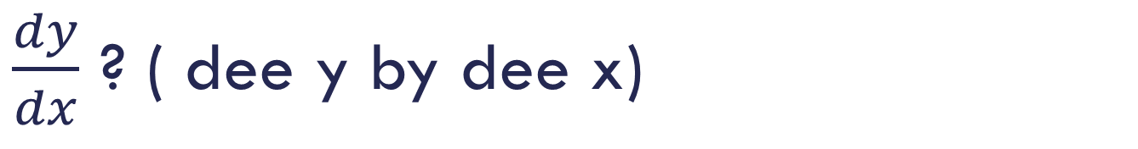
$\frac{dy}{dx}$ ? ( dee y by dee x)
$\frac{dy}{dx}$ is an expression for the gradient of a curve.
As we have seen, in a curve the gradient changes at each point so it is no surprise that for the gradient, $\frac{dy}{dx}$ you get a function of x and not a constant
In our example where $y=x2$, $\frac{dy}{dx}=2x$

Slide 6
Specific points
y = x²
Now we have a general expression for the gradient of this curve we can find the gradient at any number of points on y = x²
at x = 1
at x = -2

Slide 7
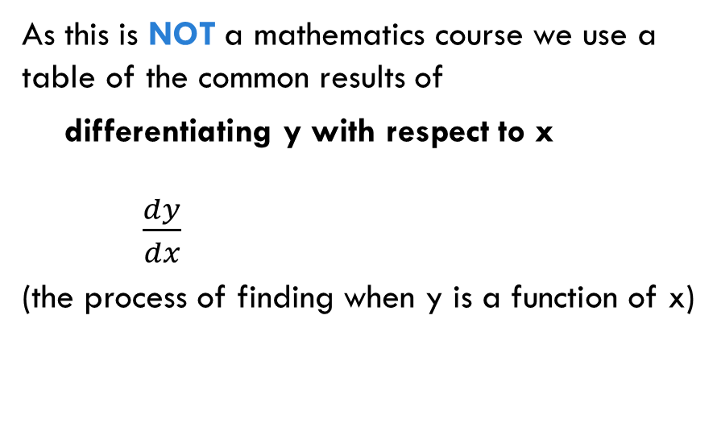
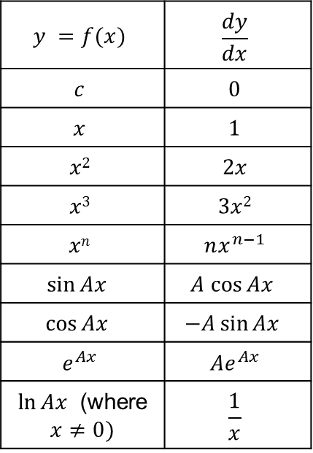

Quick reference
$$y =f(x)$$ | $$\frac{dy}{dx}$$
$$c$$ | $$0$$
$$x$$ | $$1$$
$$x2$$ | $$2x$$
$$x3$$ | $$3x2$$
$$xn$$ | $$nx^{n−1}$$
$$\sin{Ax }$$ | $$A cos{Ax }$$
$$\cos{Ax }$$ | $$−A\sin{Ax }$$
$$e^{Ax}$$ | $${Ae}^{Ax}$$
$\ln{Ax }$ (where $x≠0)$ | $$\frac{1}{x}$$
As this is NOT a mathematics course we use a table of the common results of
differentiating y with respect to x $\frac{dy}{dx}$
(the process of finding when y is a function of x)
*Where $A$ is a constant
**There are many other functions …

Slide 8
Example
Find dy/dx for y = x⁴ and evaluate it when x = 5
From the table
Here n = 4
So dy/dx = 4(x)³
At x = 5
dy/dx = 4(5)³ = 4(125) = 500
y | dy/dx
x^{n} | nx^{n-1}

Slide 9
Combinations with + and -
If you have a combination of functions added or subtracted you can differentiate them one at a time.*
E.g. Differentiate y = x² +x
From the table we see
dy/dx = 2x+1
(*NB this does not apply to division or multiplication)
y =f(x) | dy/dx
x | 1
x² | 2x

Slide 10
Scalar multiplication
We can see that if we have to differentiate a scalar multiple of a function (remember a scalar is just an ordinary number) we can carry this through the process.
E.g. y = 3x²
= x² + x² + x² so
dy/dx = 2x +2x+2x = 6x
Alternatively
y = 3x² =3(x²)
dy/dx = 3(2x) = 6x (by carrying the 3 throughout)
y | dy/dx
x² | 2x

Slide 11
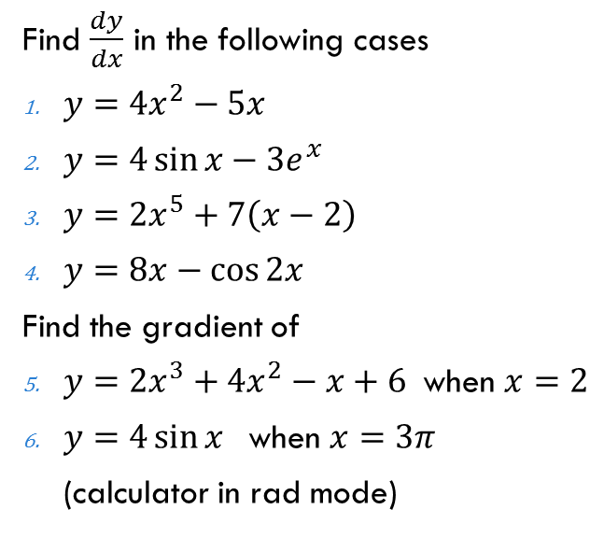

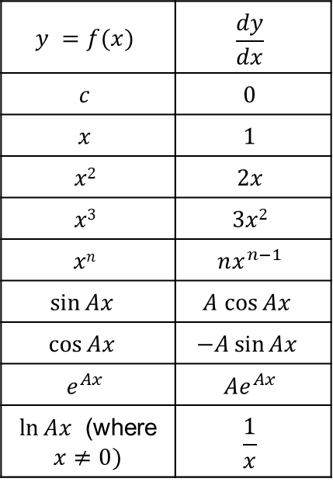
Practise makes perfect
Solutions
$\frac{dy}{dx}=8x−5$
$\frac{dy}{dx}=4\cos{x−3e^{x}}$
$\frac{dy}{dx}=10x^{4}+7$
$\frac{dy}{dx}=8+2\sin{2x}$
$\frac{dy}{dx}=6x^{2}+8x−1$
$x=2$, gradient $=39$
$\frac{dy}{dx}=4\cos{x}$
$x=3π$, gradient $= −4$
Find $\frac{dy}{dx}$ in the following cases
$y=4x^{2}−5x$
$y=4\sin{x−3e^{x}}$
$y=2x^{5}+7\left(x−2\right)$
$y=8x−\cos{2x}$
Find the gradient of
$y=2x^{3}+4x^{2}−x+6$when $x=2$
$y=4\sin{x}$when $x=3π$
(calculator in rad mode)
$$y =f(x)$$ | $$\frac{dy}{dx}$$
$$c$$ | $$0$$
$$x$$ | $$1$$
$$x2$$ | $$2x$$
$$x3$$ | $$3x2$$
$$xn$$ | $$nx^{n−1}$$
$$\sin{Ax }$$ | $$A cos{Ax }$$
$$\cos{Ax }$$ | $$−A\sin{Ax }$$
$$e^{Ax}$$ | $${Ae}^{Ax}$$
$\ln{Ax }$ (where $x≠0)$ | $$\frac{1}{x}$$

Slide 12
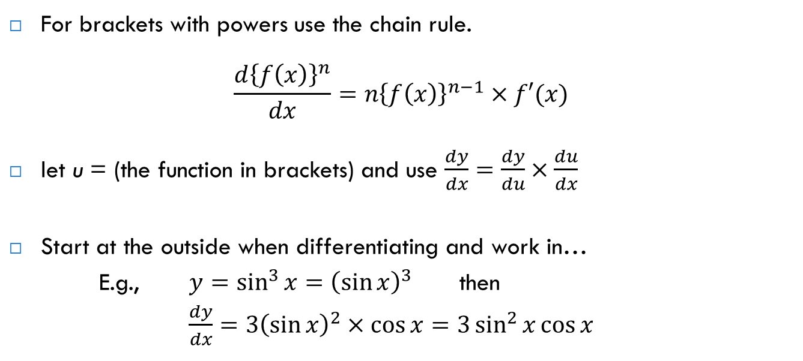
Chain Rule for differentiation
For brackets with powers use the chain rule.
$$\frac{d{\left\{f\left(x\right)\right\}}^{n}}{dx}=n{\left\{f\left(x\right)\right\}}^{n−1}×f′(x)$$
let u = (the function in brackets) and use $\frac{dy}{dx}=\frac{dy}{du}×\frac{du}{dx}$
Start at the outside when differentiating and work in…
E.g., $y=\sin^{3}{x}={\left(\sin{x}\right)}^{3}$ then
$\frac{dy}{dx}=3{\left(\sin{x}\right)}^{2}×\cos{x}=3\sin^{2}{x}\cos{x}$

Slide 13
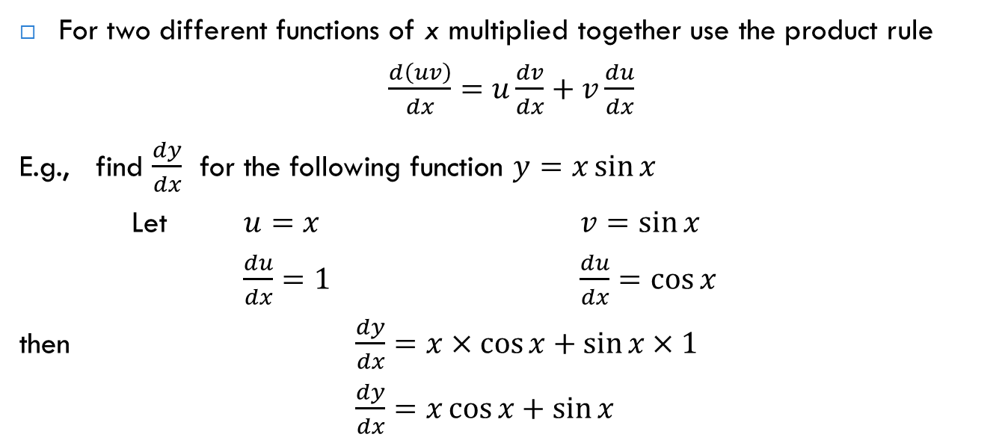
Product Rule for differentiation
For two different functions of x multiplied together use the product rule
$\frac{d\left(uv\right)}{dx}=u\frac{dv}{dx}+v\frac{du}{dx}$
E.g., find $\frac{dy}{dx}$ for the following function $y=x\sin{x}$
Let $u=x$ $v=\sin{x}$
$\frac{du}{dx}=1$ $\frac{du}{dx}=\cos{x}$
then $\frac{dy}{dx}=x×\cos{x}+\sin{x}×1$
$\frac{dy}{dx}=x\cos{x}+\sin{x}$

Slide 14
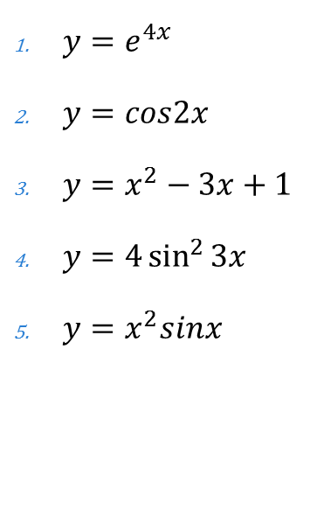


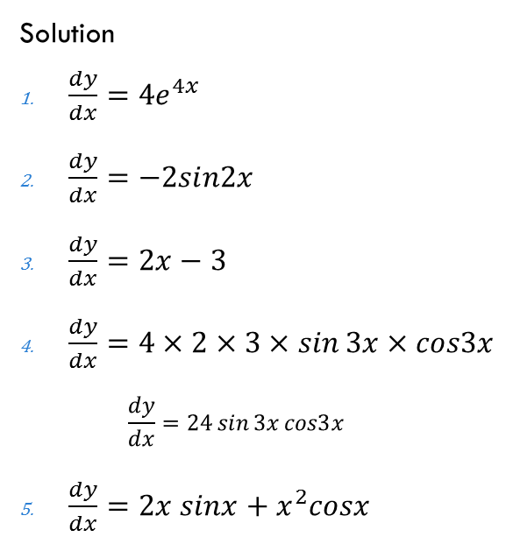
Find $\frac{dy}{dx}$ for the following
Solution
$\frac{dy}{dx}=4e^{4x}$
$\frac{dy}{dx}=−2sin2x$
$\frac{dy}{dx}=2x−3$
$\frac{dy}{dx}=4×2×3×\sin{3x}×cos3x$
$$\frac{dy}{dx}=24\sin{3x}cos3x$$
$\frac{dy}{dx}=2x sinx+x^{2}cosx$
$y=e^{4x}$
$y=cos2x$
$y=x^{2}−3x+1$
$y=4\sin^{2}{3x}$
$y=x^{2}sinx$
$y=e^{3x^{2}}$
Solution
$\frac{dy}{dx}=3×2x×e^{3x^{2}}$
$$\frac{dy}{dx}=6xe^{3x^{2}}$$

Slide 15
Maximum and Minimum (Turning points)
Gradient = 0 here as there is no change in y

Slide 16
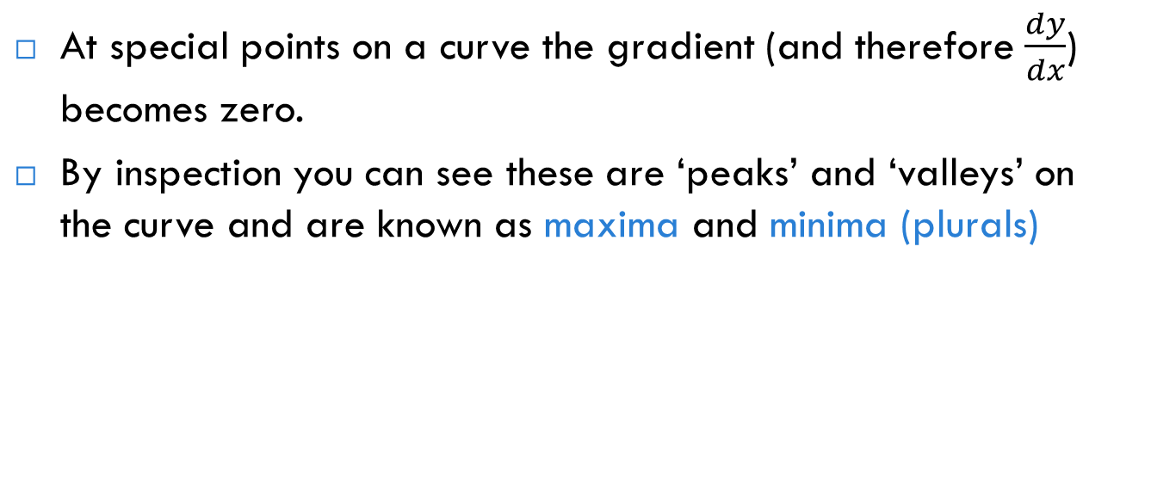
Applications – max and min
At special points on a curve the gradient (and therefore $\frac{dy}{dx}$) becomes zero.
By inspection you can see these are ‘peaks’ and ‘valleys’ on the curve and are known as maxima and minima (plurals)
maximum
maximum (local)
minimum

Slide 17
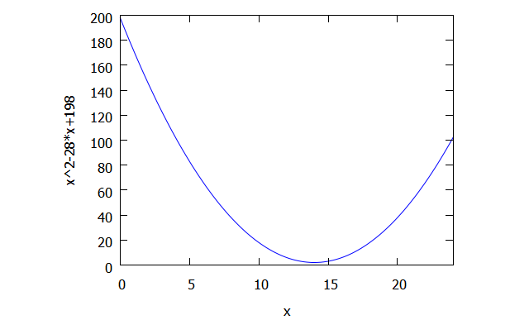
Example
The temperature in a warehouse drops during the night. A sensor has recorded the temperatures from 12 noon over a 24hr period and the computer has fitted a simple quadratic function to this period
y = x² -28x +198
where x is the time in hours after the start and y is the temperature in centigrade
There are cucumbers in the warehouse which must not freeze. Find out what time the minimum temperature occurs and whether the cucumbers are safe

Slide 18
Solution
y = x² -28x +198
and for a minimum the gradient will be = 0
Differentiating
dy/dx = 2x – 28 and for a minimum
dy/dx = 2x-28 = 0 so x = 14
(14 hours after the sensor started at noon so at 2am)
To find whether the cucumbers are safe we need to know the temperature, y, at x = 14
y = x² -28x +198 so at x = 14 y= (14)² – 28(14) + 198 = 2
(phew!) A temperature of 2⁰C
This is just above freezing so the cucumbers should be OK

Slide 19
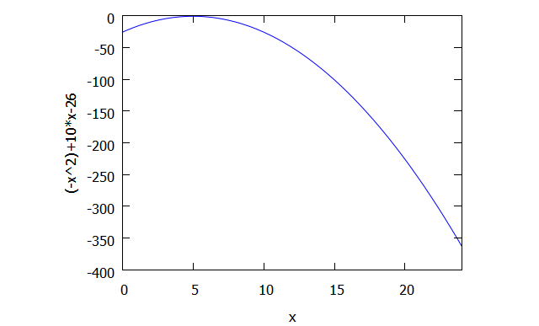
The opposite problem
The temperature in a warehouse rises during the day. A sensor has recorded the temperatures from 7 am over a 24hr period and the computer has fitted a simple quadratic function to this period of
y = -x² +10x -26
where x is the time in hours after the start and y is the temperature in centigrade
There is ice cream in the warehouse which must be in temperatures below -6⁰ C. Find out what time the maximum temperature occurs and whether the ice cream will spoil.

Slide 20
Solution
y = -x² +10x -26
and for a maximum the gradient will be = 0
Differentiating
dy/dx = -2x +10 and for a maximum
dy/dx = -2x+10 = 0 so x = 5
(5 hours after the sensor started at 7am so at noon)
To find whether the ice cream is OK we need to know the temperature, y, at x = 5
y = -x² +10x -26 so at x = 5 y= -(5)² +10(5) -26 = -1
(oh no!) A temperature of -1⁰ C
This is above the required freezing
so the ice cream will spoil

Slide 21
Catching
A graduate throws his cap into the air and its path follows the equation
y = 1+19.6x -4.9x²
where x is the time in seconds and y the height in metres
When does it reach it maximum height and what is it?
y = 1+19.6x -4.9x² so dy/dx = 19.6-4.9(2x) = 19.6 – 9.8x
For a maximum dy/dx = 0 so 19.6 -9.8x = 0 x = 19.6/9.8 = 2
The hat reaches its maximum height after 2 seconds
To find this height we put x = 2 in the original equation which describes the path y = 1+19.6x -4.9x² so y = 1+19.6(2) -4.9(4) = 20.6 m
WOW must have done Sports Science!

Slide 22
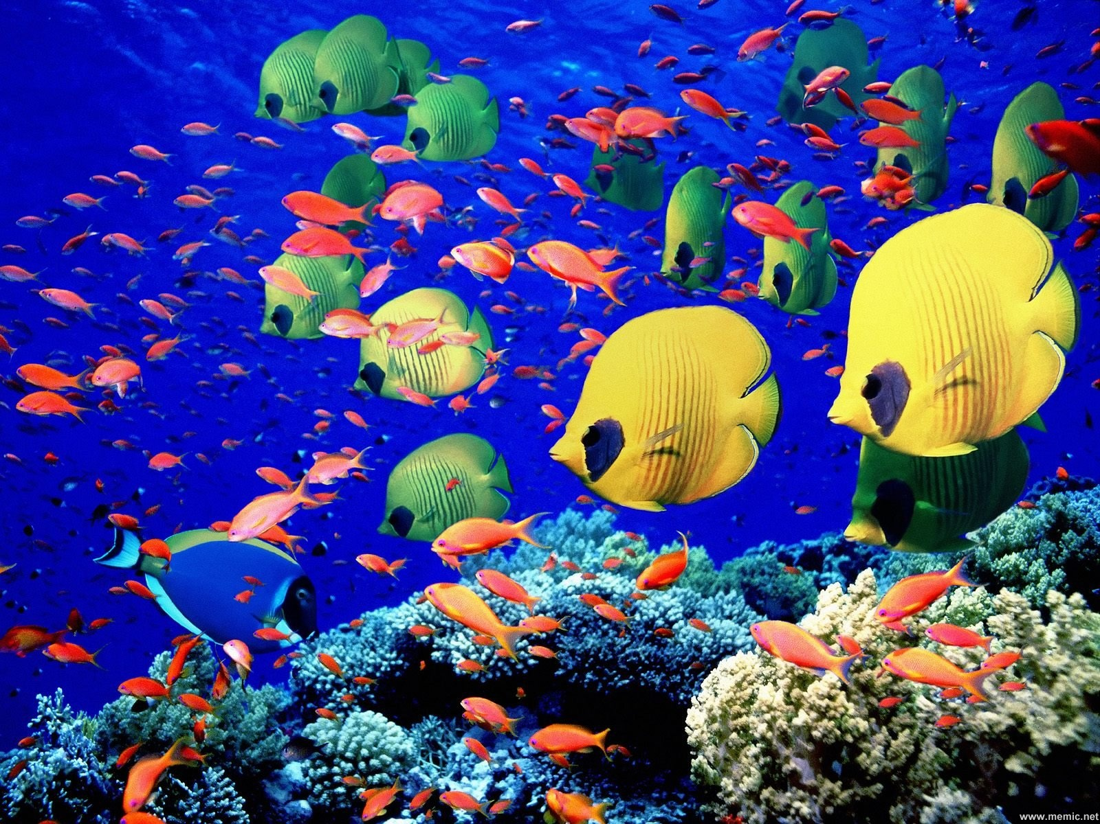
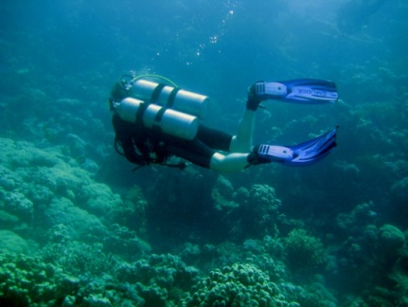
Dive example
Skip
Under the terms of their insurance a diver in Manado must not go below 30m
The dive computer shows erratic depths following a curve
y =0.001(x³+135/2 x² + 600x) -10
Where y is the depth in metres and x is the time in minutes after the start of the dive
Is the diver in trouble?
If so when did this occur?

Slide 23
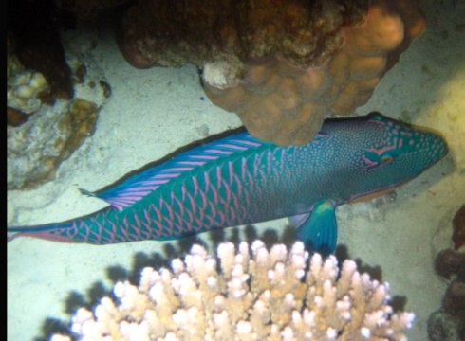
y =0.001(x³+135/2 x² + 600x) -10
For a minimum we need to find dy/dx and find when it is 0
dy/dx = 0.001(3x² + 135x +600)
As d/dx (kf(x)) = k d/dx(f(x))
If dy/dx = 0 then 3x² + 135x +600= 0
Solve by factorising or formula
(3x-15)(x-40) = 0 so x = 5,40

Slide 24
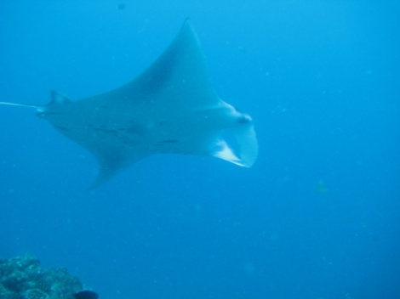
(3x-15)(x-40) = 0 so x = 5,40
Is the diver in trouble after 5 minutes? What is y?
y =0.001((5)³+135/2 (5)² + 600(5)) -10 = -8.6m
This can’t be a problem. What about x = 40?
y =0.001((40)³+135/2 (40)² + 600(40)) -10 = -30m
If this is the minimum the diver is just OK!

Slide 25
Dive profile
In fact the function looks like this printout below
It has a maxima and a minima as it is a cubic
( the biggest power of x is 3)

Slide 26
Sines and cosines and signals
When differentiating these make sure your angles are calculated in radians
You will need to get quite good at this in year 2 for signal processing
If you are interested in taking calculus further many standard A level text books will give a good introduction
Be careful not to jump into Fourier analysis of signals too soon- for a gentle approach to understanding waves try this site:

Slide 27
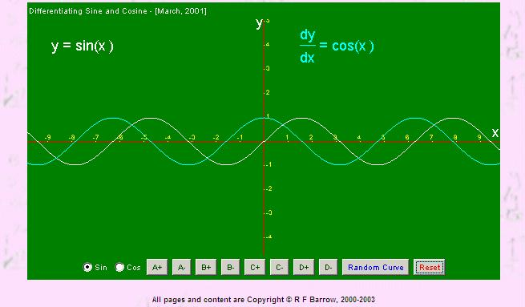
http://www.waldomaths.com/Diff1N.jsp Also a good site in general for maths revision

Slide 28
Integration
This arises from another practical problem – that of finding the area of a shape. In particular we can apply it to the problem of the area under a curve given by the equation y = f(x)
With simple shapes we can count squares or calculate triangles but not with curves

Slide 29
Estimation using rectangles
Overestimate
=(max height )× (width)
=max y × max x
y = f(x)
y
Underestimate
= (min height) × (width)
=min y × max x
y
x
AREA
required

Slide 30
Here y = f(x) and y = x²+2 we are interested in the area between the x axis, the curve and the lines x = 0 and x = 4
x | y
0 | 2
1 | 3
2 | 6
3 | 11
4 | 18
y = x²+2
Overestimate = 18x4 = 72
Underestimate = 2x4 = 8

Slide 31
How good is our estimate?
Overestimate = 18x4 = 72
Underestimate = 2x4 = 8
Not very as there is a huge difference between 8 and 72
y = x²+2
31

Slide 32
Improving by finer mesh
There are a few ways to improve this but Integration takes the route of making a finer mesh
It tries to cut up the area so that the rectangles it uses are smaller in width
This is also the basis for numerical solutions like Simpson’s Rule used in packages.

Slide 33
Better estimate by dividing the width with 2 rectangles
x | y
0 | 2
1 | 3
2 | 6
3 | 11
4 | 18
Less error
Overestimate = sum of
18x2 = 36
6x2 = 12
Total sum = 48
Less error
Underestimate = sum of
6x2 =12
2x2 = 4
Total sum = 16

Slide 34
Better estimate
Overestimate = 18x4 = 72
Underestimate = 2x4 = 8
V1
V 2
Overestimate = sum of
18x2 = 36
6x2 = 12
Total sum = 48
0
100
Underestimate = sum of
6x2 =12
2x2 = 4
Total sum = 16

Slide 35
Better estimate by dividing the rectangles AGAIN
x | y
0 | 2 | y(0)
1 | 3 | y(1)
2 | 6 | y(2)
3 | 11 | y(3)
4 | 18 | y(4)
We write the value of y when x = 0 as y(0)
y(4)
Overestimate = sum of
18x1 = 18 11x1 = 11
6x1 = 6 3x1 = 3
Total sum = 38
y(3)
y(2)
Underestimate = sum of
11X1 = 11 6x1 =6
3x1 = 3 2x1 = 2
Total sum = 22
y(1)
y(0)

Slide 36
Better estimate
Overestimate = 18x4 = 72
V1
Underestimate = 2x4 = 8
0
V2
100
V3
Overestimate = sum of
18x2 = 36
6x2 = 12
Total sum = 48
Overestimate = sum of
18x1 = 18 11x1 = 11
6x1 = 6 3x1 = 3
Total sum = 38
Underestimate = sum of
6x2 =12
2x2 = 4
Total sum = 16
Underestimate = sum of
11X1 = 11 6x1 =6
3x1 = 3 2x1 = 2
Total sum = 22

Slide 37
Estimating the area
We can see we are getting closer to the real area by bringing the upper estimate down and the lower estimate up
First 8< Area <72 here width each rectangle x = 4
y(0)x4< Area <y(4)x4
Second 16< Area <48 here width each rectangle x = 2
y(0)x2 +y(2)x2< Area < y(4)x2 + y(2)x2
Third 22< Area <38 here width each rectangle x = 1
y(0)x1 +y(1)x1+ y(2)x1 +y(3)x1 < Area < y(4)x1 + y(3)x1 y(2)x1 + y(1)x1

Slide 38
And a fourth attempt?
Fourth try with width x = 0.5 25.5< Area <33.5
y(0)x0.5+y(0.5)x0.5+y(1)x).5+y(1.5)x0.5+y(2)x0.5+y(2.5)x0.5+y(3)x0.5+y(3.5)x0.5< Area < y(4)x0.5+y(3.5)x0.5+y(3)x0.5+y(2.5)x0.5+y(2)x0.5+y(1.5)x0.5+y(1)x0.5+y(0.5)x0.5
x | y | Area=y*0.5
0 | 2 | 1
0.5 | 2.25 | 1.125
1 | 3 | 1.5
1.5 | 4.25 | 2.125
2 | 6 | 3
2.5 | 8.25 | 4.125
3 | 11 | 5.5
3.5 | 14.25 | 7.125
4 | 18 | 9
 | overestimate | 33.5
 | underestimate | 25.5
y (x + width)
y (x)
x
x + width

Slide 39
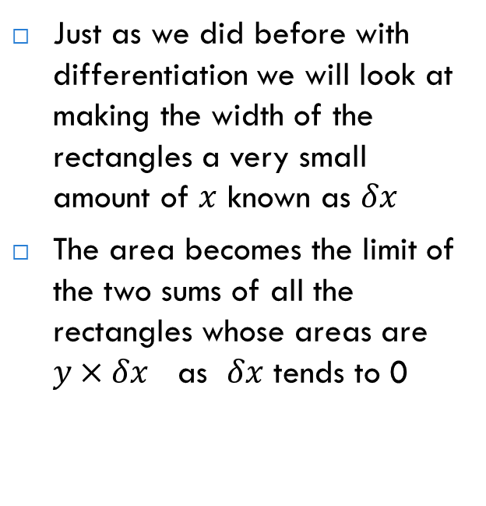
Theory (optional)
Just as we did before with differentiation we will look at making the width of the rectangles a very small amount of $x$ known as $δx$
The area becomes the limit of the two sums of all the rectangles whose areas are $y×δx$ as $δx$ tends to 0
y(x+ )
y
x
x+

Slide 40
Integration (definitely)
The rigorous theory of integration is beyond the scope of this course but this limit of the area of a curve y = f(x) between the two boundaries a and b is know as the integral of y with respect to x between x = a and x = b and written
y = f(x)
x = a
x = b

Slide 41
How do we get the answer?
The Fundamental Theorem of Calculus (look it up if you are interested) enables us to link integration with differentiation in such a way that integration is often thought of as the reverse operation to differentiation
From the table for the common functions we can see this relationship

Slide 42
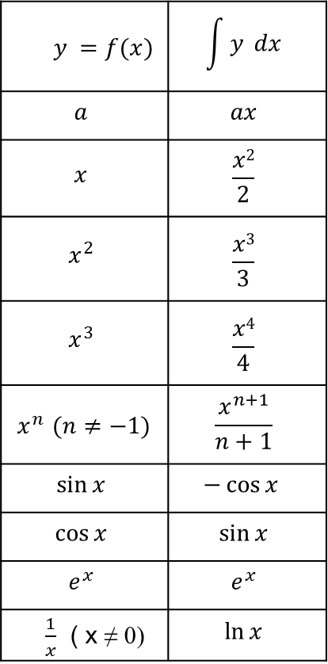
Backwards and forwards
$$y =f(x)$$ | $$\int{y} dx$$
$$a$$ | $$ax$$
$$x$$ | $$\frac{x2}{2}$$
$$x^{2}$$ | $$\frac{x3}{3}$$
$$x^{3}$$ | $$\frac{x4}{4}$$
$x^{n}$ $(n≠−1)$ | $$\frac{x^{n+1}}{n+1}$$
$$\sin{x}$$ | $$−\cos{x }$$
$$\cos{x}$$ | $$\sin{x}$$
$$e^{x}$$ | $$e^{x}$$
$\frac{1}{x}$ ( x ≠ 0) | $$\ln{x}$$
So we can see here if y = x²
And if we differentiated
Here c is known as the constant of integration

Slide 43
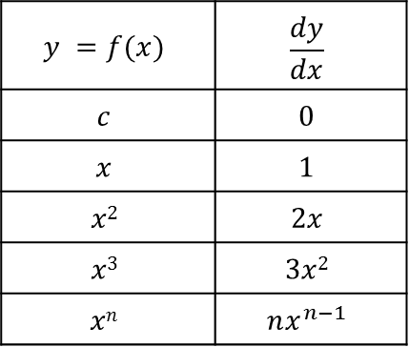
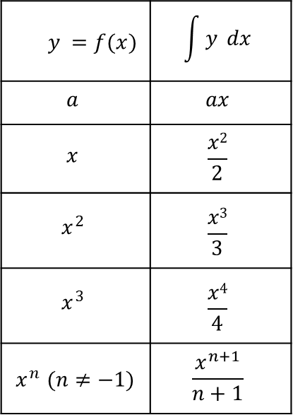
Simple powers of x
$$y =f(x)$$ | $$\int{y} dx$$
$$a$$ | $$ax$$
$$x$$ | $$\frac{x2}{2}$$
$$x^{2}$$ | $$\frac{x3}{3}$$
$$x^{3}$$ | $$\frac{x4}{4}$$
$x^{n}$ $(n≠−1)$ | $$\frac{x^{n+1}}{n+1}$$
$$y =f(x)$$ | $$\frac{dy}{dx}$$
$$c$$ | $$0$$
$$x$$ | $$1$$
$$x2$$ | $$2x$$
$$x3$$ | $$3x2$$
$$xn$$ | $$nx^{n−1}$$
Integration
Differentiation
x
7
x
x
x
8
7
6
7
8
7
7
Put the power in front and reduce the old power by 1
Increase the power by 1 divide by this new power

Slide 44
Definite and indefinite
When we are not applying integration to a problem within limits we call it indefinite integration and we must use the constant of integration
This is because differentiating
y=x², y=x²+7, y=x²-4, y=x²-0.5, y=x²+c would all give the answer 2x.
So integrating 2x we give the answer with + c

Slide 45
Combinations with + and -
If you have a combination of functions added or subtracted you can integrate them one at a time.*
Multiples are dealt with in the same way as in differentiation
You only need one constant of integration
E.g.
(*NB this does not apply to division or multiplication)

Slide 46
Some for you
46

Slide 47
What happened to areas?
When we need to find the area under the curve using integration it is called definite integration as we find a number not just a function of x.
This is like the difference between finding an expression for the gradient and finding the actual gradient for known value of x.
We need to know what part of the curve we are finding and so we need the values of x that form the limits of the area together with the curve and the x axis
We integrate as usual and then evaluate by putting the values of x into the integrated expression

Slide 48
Evaluating a definite integral
This is a special case as the bottom limit is x = 0 and does not need any calculation
Note the dot over the 3 means it recurs and could be written 29.33333333333333333…. Or 29.3 rec. Or 29.3(1dp)
y = x²+2
Area Required

Slide 49
With both limits to evaluate
This time we only require the area between x = 2 and x = 4 so we evaluate the integral with both values of x and subtract the second from the first
Answer = 22.7 (1dp)
y = x²+2
Area Required
x = 2
x = 4

Slide 50
Another example
Find the area between the curve y = 3x²-5x-9, the x axis and the limits x = -1 and x = 2
The integration gives a negative
answer as the area is
below the y axis

Slide 51
One for you to do
Sketch the function y = 6x ²+5
Find the area enclosed by the curve, the x axis and the lines x = 1 and x = 3

Slide 52
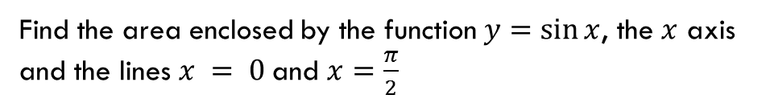
Another for you to do
Find the area enclosed by the function $y=\sin{x}$, the $x$ axis and the lines $x = 0$and $x=\frac{π}{2}$

